Slide 1
Introduction to Food Retailing and Food Service
Food retailing and food service encompass the various channels through which consumers can access and purchase food products. This includes grocery stores, supermarkets, convenience stores, restaurants, cafes, and food delivery services, among others. These sectors play a crucial role in the overall food supply chain and economy.
by NALINI ARUMUGAM

Slide 2
Overview of the Food Retailing Industry
Diverse Formats
Changing Consumer Preferences
Food retailing encompasses a wide range of store formats, from large supermarkets and hypermarkets to convenience stores, specialty shops, and online retailers.
Shoppers today demand convenience, quality, and a personalized shopping experience, driving changes in product assortment, store design, and customer service.
Intense Competition
Importance of Supply Chain
The food retailing industry is highly competitive, with players vying for market share through pricing, promotions, product innovation, and enhanced customer experiences.
Efficient supply chain management is crucial in the food retailing industry, ensuring timely delivery of fresh, high-quality products to consumers.

Slide 3
Key Players in the Food Retailing Industry
Supermarket Chains: Major players like Tesco, Giant, and AEON dominate the Malaysian grocery market with their vast store networks and strong brand recognition.
Hypermarket Operators: Retailers like Parkson and Mydin operate large hypermarket formats offering a wide range of food and non-food products.
Convenience Store Chains: 7-Eleven, Family Mart, and other convenience store chains have grown rapidly, providing quick food and grocery options for urban consumers.

Slide 4
Trends in the Food Retailing Industry
Rise of Omnichannel Retailing
1
Consumers expect a seamless shopping experience across multiple channels, from in-store to online. Retailers are integrating physical and digital touchpoints to meet this demand.
2
Emphasis on Convenience
Consumers seek faster, easier, and more personalized shopping options, leading to the growth of convenience stores, meal delivery services, and cashier-less checkout technologies.
Focus on Health and Wellness
3
Consumers are increasingly health-conscious, driving retailers to offer a wider variety of organic, natural, and specialty food products to cater to this demand.

Slide 5
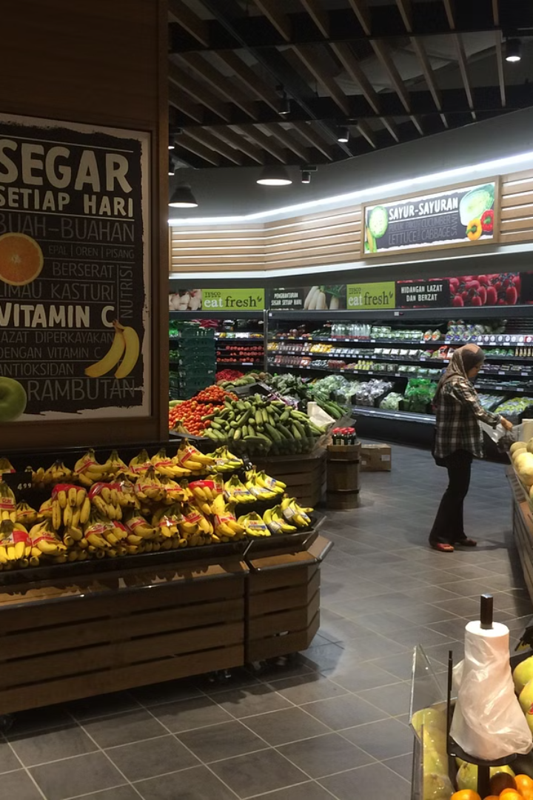
Importance of Food Retailing in Malaysia
Food retailing plays a crucial role in Malaysia's economy, providing access to essential groceries and supporting local food production. It serves as a vital distribution channel, connecting producers to consumers across the diverse regions of the country.
Malaysians rely on a robust food retailing industry to meet their daily nutritional needs, with supermarkets, convenience stores, and traditional markets scattered throughout urban and rural areas. This accessibility is a key factor in the country's food security.

Slide 6
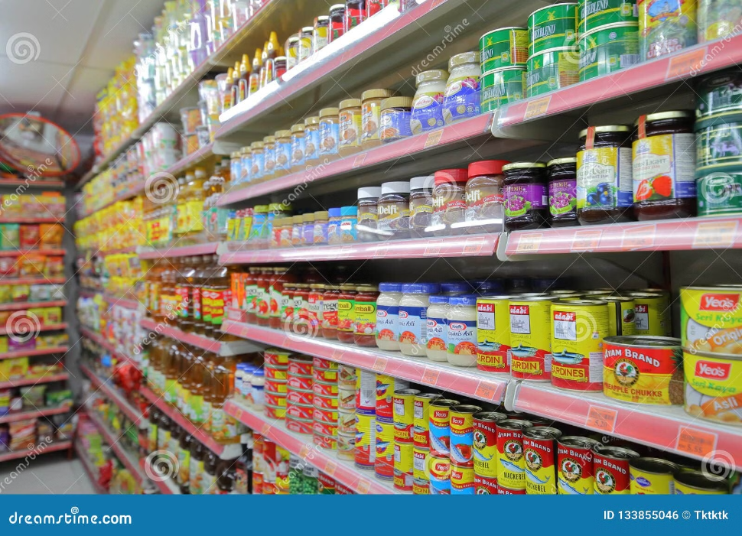
Challenges Faced by the Food Retailing Industry in Malaysia
The food retailing industry in Malaysia faces several key challenges, including intense competition from both local and international players, rising operational costs such as rent and labor, and the need to adapt to changing consumer preferences and shopping habits.
One major obstacle is the rapid growth of e-commerce and online grocery shopping, which has disrupted traditional brick-and-mortar stores. Retailers must invest in digital infrastructure and logistics to compete in the omnichannel landscape.
Another challenge is the fragmented nature of the industry, with many small-to-medium sized retailers struggling to achieve economies of scale. Consolidation and partnerships may be necessary for these players to remain competitive.

Slide 7
Strategies for Success in the Malaysian Food Retailing Industry
1
Embrace Digitalization
2
Emphasize Convenience and Accessibility
Leverage e-commerce platforms, mobile apps, and AI-powered technologies to enhance the shopping experience, streamline operations, and reach a wider customer base.
Strategically locate stores, offer convenient pickup and delivery options, and ensure a seamless omnichannel experience to cater to the busy lifestyles of Malaysian consumers.
3
Differentiate with Unique Product Offerings
4
Prioritize Customer Service Excellence
Curate a diverse range of high-quality, locally-sourced products and introduce innovative, trendy items to stand out in the competitive market.
Invest in well-trained and friendly staff, implement efficient complaint handling processes, and foster a customer-centric culture to build brand loyalty.

Slide 8
Overview of the Food Service Industry
The food service industry encompasses a diverse range of businesses that provide meals, snacks, and beverages to customers, including restaurants, cafes, catering companies, and food trucks. This industry plays a crucial role in meeting the dining and culinary needs of both individuals and organizations.

Slide 9
Key Players in the Food Service Industry
Restaurant Chains
Catering Companies
Hotels and Resorts
Institutional Foodservice
Large restaurant chains like McDonald's, Starbucks, and Subway dominate the food service industry, offering standardized dining experiences across multiple locations.
Catering firms provide specialized food services for events, meetings, and other functions, often delivering high-quality, customized meals.
Hotels and resorts operate in-house food service operations, ranging from casual dining to fine-dining restaurants, to cater to their guests.
Hospitals, schools, and other institutions have their own food service operations to provide meals and refreshments to their staff, students, and patients.

Slide 10
Trends in the Food Service Industry
Health Consciousness
Consumers demand more nutritious and plant-based menu options, driving food service providers to cater to dietary preferences.
Personalization
Customizable meals, special orders, and personalized dining experiences become increasingly important to meet diverse customer needs.
Technology Integration
Food service embraces digital ordering, contactless payment, and self-service kiosks to enhance efficiency and customer convenience.

Slide 11
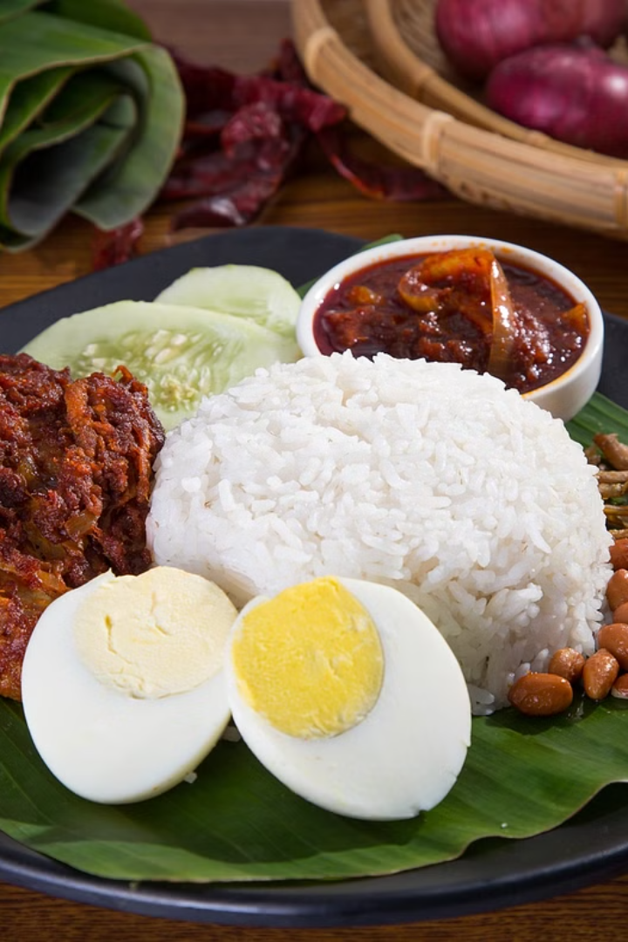
Importance of Food Service in Malaysia
The food service industry plays a vital role in Malaysia's economy, contributing significantly to job creation, GDP, and the overall dining experience. It caters to the diverse culinary preferences of both locals and tourists, showcasing the country's rich gastronomic heritage.
Food service establishments, ranging from hawker stalls to fine-dining restaurants, are integral to the social fabric of Malaysian communities, providing gathering places for family, friends, and colleagues to connect over delicious meals.

Slide 12
Challenges Faced by the Food Service Industry in Malaysia
The Malaysian food service industry faces several key challenges, including rising food and labor costs, stiff competition, and changing consumer preferences. High operating expenses, such as rent and utilities, put pressure on profit margins, while the need to attract and retain skilled staff adds to the burden. Shifting consumer trends towards healthier and more diverse cuisine also require food service businesses to continuously adapt their offerings.
Additionally, the industry must navigate a complex regulatory landscape, ensuring compliance with food safety standards and obtaining necessary licenses and permits. Inconsistent quality control and supply chain disruptions can also hinder the industry's growth and profitability.

Slide 13
Strategies for Success in the Malaysian Food Service Industry
1
Emphasize Local Flavors
2
Embrace Technology
Leverage the diverse culinary traditions of Malaysia to offer unique and authentic dining experiences that cater to local tastes and preferences.
Invest in digital solutions to enhance customer experience, streamline operations, and stay ahead of industry trends.
3
Focus on Sustainability
4
Develop Strong Supply Chain Partnerships
Implement eco-friendly practices, such as reducing food waste, using locally-sourced ingredients, and promoting sustainable packaging, to appeal to environmentally-conscious consumers.
Cultivate strategic relationships with reliable suppliers, logistics providers, and distributors to ensure a steady flow of high-quality ingredients and efficient delivery.

Slide 14
Comparison of Food Retailing and Food Service in Malaysia
Retail Reach
Customer Experience
Product Offerings
Business Models
Food retailing in Malaysia has a wider reach, with supermarkets, convenience stores, and hypermarkets spread across the country. Food service is more concentrated in urban areas, with a higher density of restaurants, cafes, and catering businesses.
Food retailing operates on a high-volume, low-margin model, with a focus on efficient inventory management and supply chain logistics. Food service relies on a higher-margin, experience-driven model, with a greater emphasis on customer satisfaction and ambiance.
Food retailing focuses on a self-service experience, allowing customers to browse and select products at their own pace. Food service emphasizes personal attention and customized dining experiences, with servers catering to individual preferences.
Food retailing offers a broader range of packaged and processed goods, catering to home cooking and meal preparation. Food service specializes in freshly prepared meals, snacks, and beverages, tailored to on-site consumption.

Slide 15
Similarities and Differences between Food Retailing and Food Service
Similarities
Both food retailing and food service industries rely heavily on effective supply chain management, logistics, and distribution to ensure the timely and efficient delivery of food products to consumers. They also face similar regulatory requirements and need to maintain high standards of food safety and quality.
Differences
Food retailing is focused on selling packaged and prepared food products to consumers in a retail setting, such as supermarkets, grocery stores, and convenience stores. In contrast, food service is centered on providing meals and refreshments in a service-oriented environment, such as restaurants, cafes, and catering companies.
Another key difference is the customer experience. Food retailing is typically a transactional interaction, while food service emphasizes the overall dining experience, including ambiance, service, and presentation. Additionally, food service often requires more specialized skills, such as culinary expertise and customer service, compared to food retailing.

Slide 16
Opportunities for Collaboration between Food Retailing and Food Service
Joint Promotions
1
Retailers and restaurants can cross-promote each other's products and services to reach new customers.
Supply Chain Optimization
2
Streamlining logistics and distribution to reduce costs and improve efficiency.
Product Development
3
Collaborating on new food products and menu items that cater to evolving consumer preferences.
By working together, food retailers and food service providers can unlock synergies that benefit both industries. Leveraging complementary strengths, they can develop innovative offerings, enhance customer experiences, and drive growth in the overall food ecosystem.

Slide 17
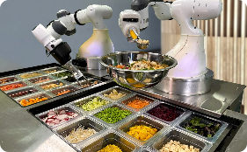
Global Trends in Food Retailing and Food Service
E-commerce and Online Grocery
Healthy and Sustainable Eating
Automation and Technology
Personalization and Customization
The rise of e-commerce has transformed food retailing, with more consumers shopping for groceries online for convenience and home delivery.
Food service is increasingly adopting automation, robotics, and digital technologies to improve efficiency, reduce labor costs, and enhance the customer experience.
Consumers globally are demanding more nutritious, locally-sourced, and environmentally-friendly food options from retailers and restaurants.
Retailers and restaurants are leveraging data analytics to offer more personalized product recommendations and customized dining experiences for their customers.

Slide 18
Lessons from Global Best Practices in Food Retailing and Food Service
Successful food retailers and service providers around the world have developed innovative strategies to enhance customer experience, optimize operations, and drive sustainable growth. Key lessons include embracing technology, prioritizing supply chain efficiency, and cultivating strong supplier relationships.
Global leaders in the industry have also demonstrated the importance of adapting to evolving consumer preferences, investing in employee training, and adopting environmentally-friendly practices. Studying these best practices can provide valuable insights for food businesses in Malaysia to enhance their competitiveness and stay ahead of the curve.

Slide 19
Sustainability and Environmental Considerations in Food Retailing and Food Service
1
Sustainable Sourcing
Prioritize local, organic, and ethically-produced ingredients.
2
Waste Reduction
Implement strategies to minimize food waste and packaging.
Energy Efficiency
3
Utilize energy-efficient equipment and renewable energy sources.
Water Conservation
4
Adopt water-saving technologies and practices.
As consumers become increasingly conscious of environmental impact, food retailers and service providers must prioritize sustainability. This includes sourcing ingredients responsibly, reducing waste, improving energy efficiency, and conserving water. By addressing these key areas, businesses can minimize their ecological footprint and meet the growing demand for eco-friendly food options.

Slide 20
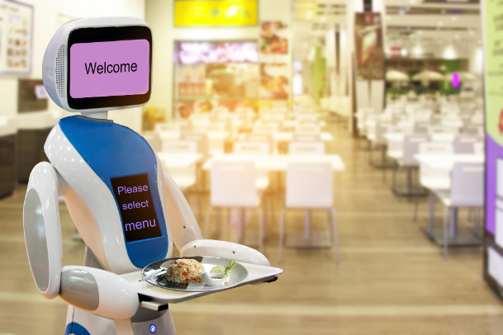
Technology and Innovation in Food Retailing and Food Service
The food retailing and food service industries are embracing new technologies to enhance customer experiences and streamline operations. From digital ordering and contactless payments to AI-powered inventory management, these innovations are transforming the way businesses operate.
Advancements in online grocery shopping, food delivery apps, and autonomous checkout systems are providing greater convenience and efficiency for consumers. Meanwhile, predictive analytics and smart supply chain technologies are helping food retailers and service providers optimize inventory, reduce waste, and improve profitability.

Slide 21
Regulatory Landscape for Food Retailing and Food Service in Malaysia
The food retailing and food service industries in Malaysia are subject to a robust regulatory framework to ensure food safety, quality, and compliance. Key regulations include the Food Act 1983, Food Hygiene Regulations 2009, and Halal certification requirements. Businesses must adhere to stringent licensing, inspection, and labeling standards.
Food handlers and establishments must also comply with regulations on food handling, storage, and waste management. Regular audits and enforcement actions by authorities like the Ministry of Health and Department of Islamic Development Malaysia (JAKIM) help maintain industry standards. Proper adherence to regulations is crucial for the long-term sustainability of food businesses in Malaysia.

Slide 22
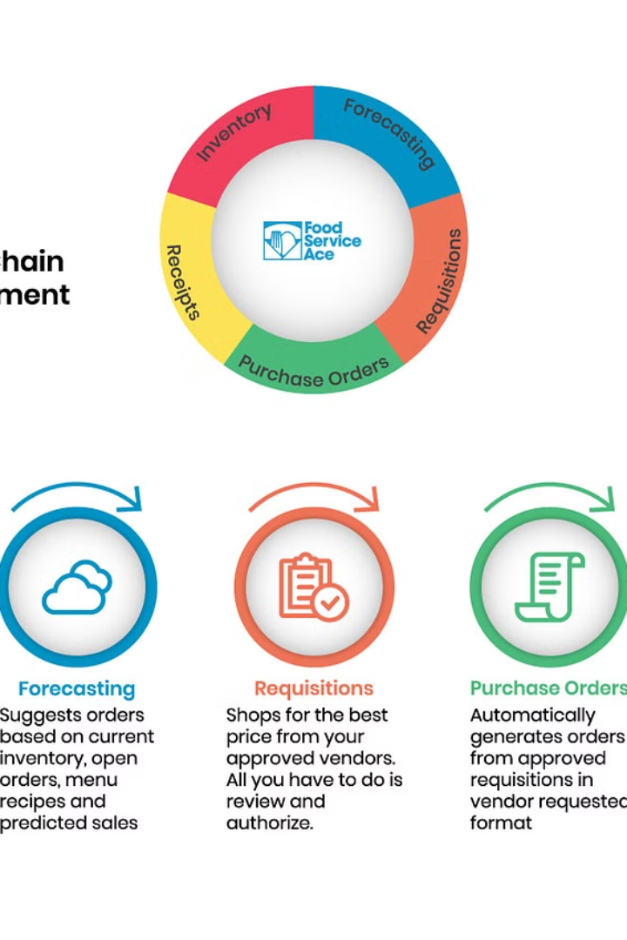
Importance of Supply Chain Management in Food Retailing and Food Service
Effective supply chain management is crucial for both food retailing and food service industries. It ensures the timely delivery of high-quality, fresh ingredients and products to consumers. Optimal logistics and distribution are key to maintaining product freshness, reducing waste, and meeting customer demand.
Proactive supply chain planning helps food businesses anticipate and respond to fluctuations in supply and demand. This agility is essential for maintaining competitive pricing and meeting evolving consumer preferences in the dynamic food industry.

Slide 23
Role of Logistics and Distribution in Food Retailing and Food Service
Efficient Transportation
Reliable and timely transportation of food products is crucial for ensuring freshness and availability in retail stores and restaurants.
Warehousing and Storage
Proper warehousing and storage facilities help maintain the quality and safety of food items throughout the supply chain.
Last-Mile Delivery
The final leg of the journey, from distribution centers to the point of sale, requires careful coordination to meet customer demands.

Slide 24
Human Resource Management in Food Retailing and Food Service
Effective human resource management is crucial in the dynamic food retailing and food service industries. These sectors require a skilled and adaptable workforce to meet the evolving needs of customers and stay competitive.
30K
20%
50%
Employees
Turnover
Part-time
The food retailing and food service industries in Malaysia employ over 30,000 workers, making HR a critical function.
The industries experience an average annual employee turnover rate of 20%, necessitating robust recruitment and retention strategies.
Approximately 50% of the workforce in these sectors are part-time or seasonal employees, requiring flexible HR policies.
Key HR responsibilities include talent acquisition, training and development, performance management, compensation and benefits, and employee engagement. Effective HR strategies can help food retailers and food service providers attract, develop, and retain top talent.

Slide 25
Future Outlook for Food Retailing and Food Service in Malaysia
Increasing Digitalization
1
The food retailing and food service industries in Malaysia are expected to become increasingly digitalized, with more online ordering, delivery, and e-commerce platforms gaining traction.
2
Sustainability Focus
Consumers are demanding more sustainable and eco-friendly practices from food retailers and restaurants, driving the industry to adopt greener solutions like reducing food waste and using renewable packaging.
Personalized Experiences
3
Tailored offerings, targeted promotions, and customized menus will become more prevalent as food businesses leverage data analytics to better understand and cater to their customers' evolving preferences.

Slide 26
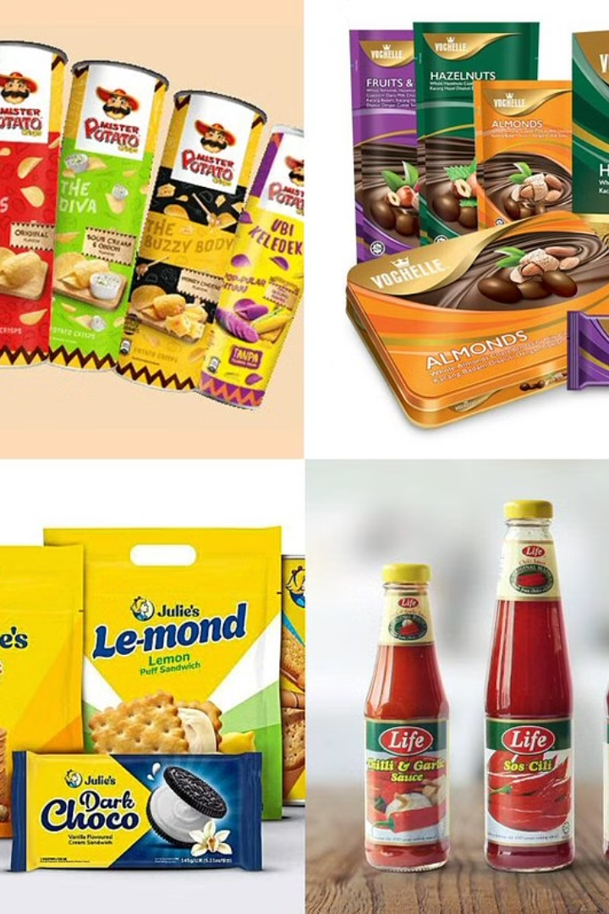
Conclusion and Key Takeaways
In conclusion, the food retailing and food service industries in Malaysia play a vital role in the country's economic and social landscape. While facing challenges, opportunities abound for businesses to thrive through strategic planning, technological innovation, and sustainable practices.

