Slide 1
MENU
EVIDENCE
SEARCH
Evidence-student tasks:
https://www.mentimeter.com/app

Slide 2
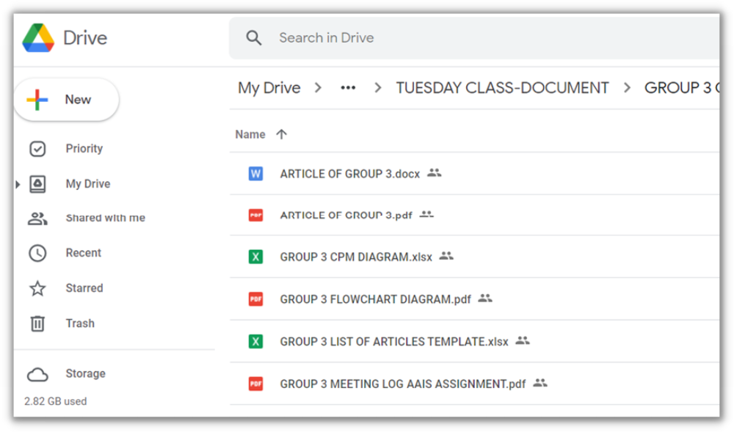
MENU
EVIDENCE
SEARCH
Evidence-student tasks:
https://drive.google.com/drive/folders/1IVtCWDpvse_
UgWtx9psf4IjQ9hQkyGBE?usp=sharing

Slide 3
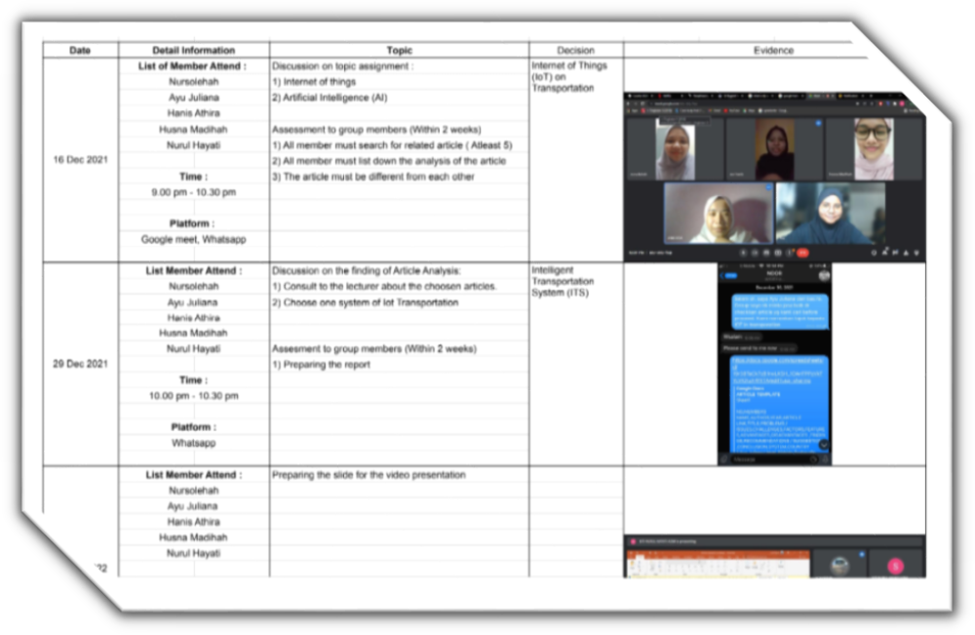
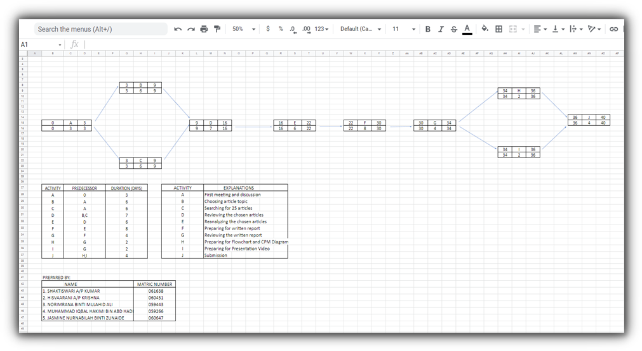
MENU
EVIDENCE
SEARCH

Slide 4
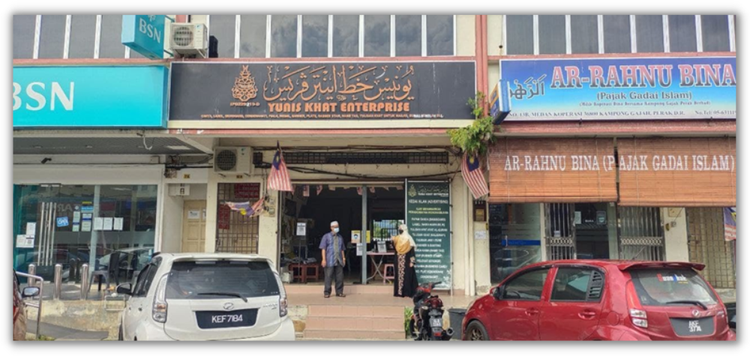
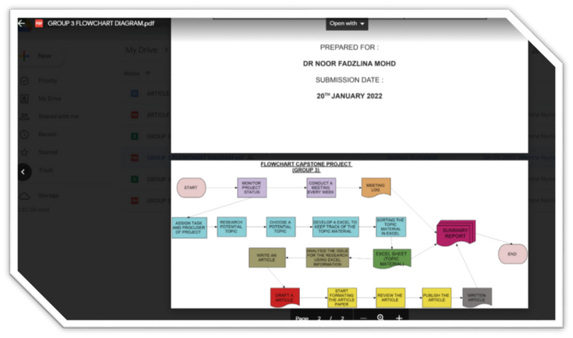
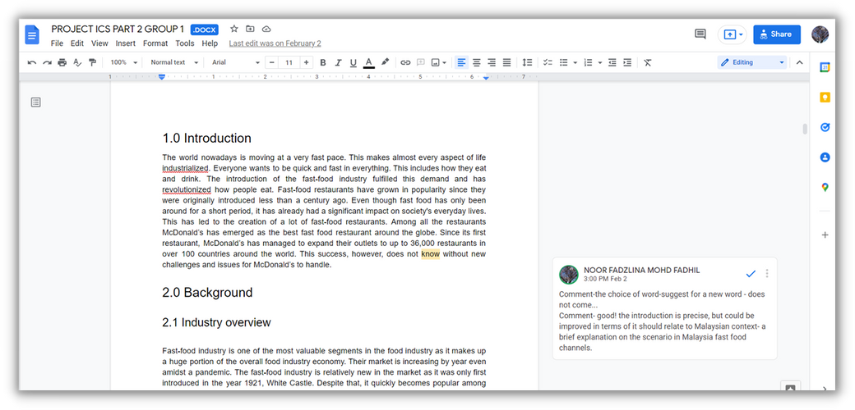
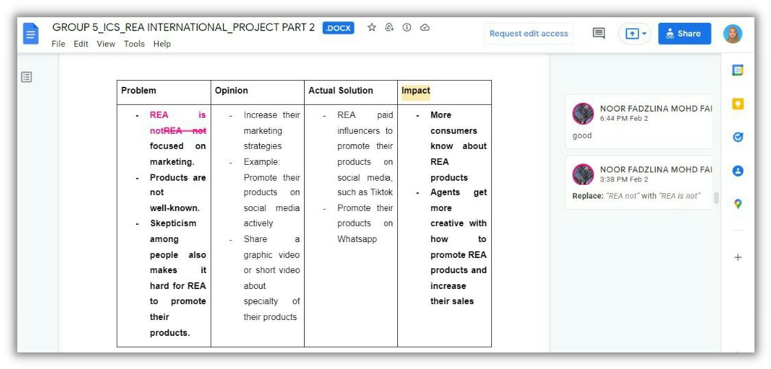
MENU
EVIDENCE
SEARCH

Slide 5
MENU
END
SEARCH
Thank You!

