Slide 1
Incorporating Learning BY DOING APPROACH Within University Accounting Courses
DR. NOOR FADZLINA MOHD FADHIL
FACULTY OF BUSINESS AND MANAGEMENT
UNIVERSITI SULTAN ZAINAL ABIDIN (UniSZA)

Slide 2
WHAT IS HAPPENING NOW?
In a real working environment, future accountants are required to obtain not only competency in digital technologies but also other important skills in which professional accountants have skill gaps. For example, critical thinking skills are relevant in the job market.
(Islam, 2017; Jr et al. 2007)
Critical thinking skills includes ‘analyzing, conceptualizing, reasoning and evaluating’
(Thompson & Washington 2015, p.2)
Nevertheless, studies show that learning technique such as memorising accounting rules and procedures is inadequate to promote critical thinking and problem solving
(Thompson & Washington, 2015)
Thus, to obtain these skills, teaching and learning in the 21st century need to be shifted from the traditional way of listening and spoon-fed into learning-by-doing
(Lombardi & Oblinger 2007)
The term which can describe this paradigm shift is ‘authentic learning’ or also known as ‘alternative learning’
(Gulikers et al. 2004; Fook & Sidhu 2010)
The question now is HOW academicians can provide these skills to accounting students?

Slide 3
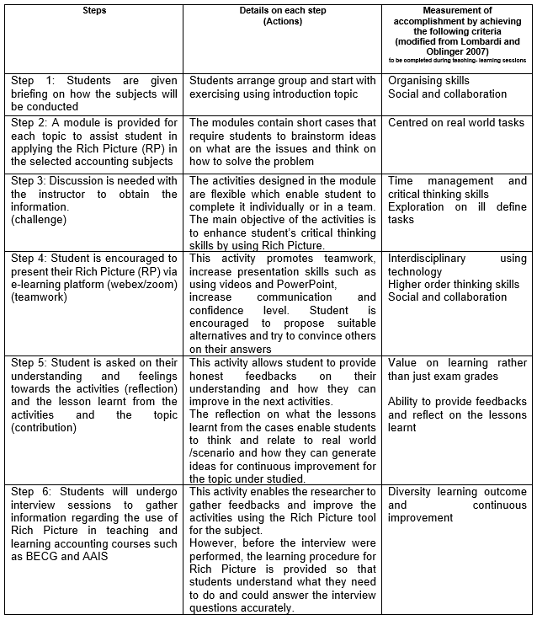
HOW? IN ORDER TO ADDRESS THE ISSUE…
To ensure the students can have fun and gather beneficial learning experiences, I employ the following strategies which consist of 6 steps, in two accounting subjects; Business Ethics and Corporate Governance (BECG), and Advanced Accounting Information System (AIS) subjects.
The main activity performed by students through the strategies implemented is
application of Rich Picture (RP) such as drawing picture/symbols/notes that includes the expression of ideas, issues, causal relationships, factors, impact and alternatives to address the problems. This activity could help to promote a student-centred learning with a critical thinking, reasoning and problem solving skills.
For example, RP is used to evaluate their understanding on BECG and AIS subjects involving analysing and proposing the best alternative for real cases scenario on technologies and ethical issues in businesses.
Teaching and learning strategies: Six steps in conducting teaching and learning in accounting subjects (Modified from Lombardi & Oblinger, 2007; Checkland, 1999)

Slide 4
REFERENCES
Berg, T. & Bell, S., 2019. Using rich pictures outside of soft systems methodology: a case study analysis. International Journal of System of Systems Engineering, 9(3), pp.257–276.
Burge, S. 2015. System thinking: approaches and methodologies an overview of the soft systems methodology pp. 1–14.
Checkland, P.B. 1999. Systems Thinking, Systems Practice. Chichester: John Wiley & Sons.
Checkland, P., 2000. Soft Systems Methodology: A Thirty Year Retrospective. Systems Research and Behavioral Science, 17, pp.11–58.
Fook, C.Y. & Sidhu, G.K., 2010. Authentic Assessment and Pedagogical Strategies in Higher Education . Journal of Sciences, 6(2), pp.153–161.
Jr, E.B.C., Duncan, J.R. & Johnson, S.D., 2007. Critical Thinking Skills of Accounting Students. repec, 1(2), pp.43–70.
Lombardi, M.M. & Oblinger, D.G., 2007. Authentic Learning for the 21st Century: An Overview. EDUCAUSE Learning Intiative advancing learning through IT innovation., pp.1–13.
Thompson, F. & Washington, H. L. 2015. ‘Critical thinking skills and teaching accounting: a comparative study’, Journal of Finance and Accountancy., 19, pp. 1–8.

