Slide 1
SAMPLES OF EVIDENCE IN TEACHING AND LEARNING USING RICH PICTURE
DR. NOOR FADZLINA MOHD FADHIL
FACULTY OF BUSINESS AND MANAGEMENT
UNIVERSITI SULTAN ZAINAL ABIDIN (UniSZA)

Slide 2
EVIDENCE IN TEACHING AND LEARNING USING RICH PICTURE (RP)
How RP is drawn?
The use of RP is flexible with no rigid rules and constraints (Horan, 2000)
As stated by (Checkland 2000, p.22), "Users need to develop skill in making 'rich pictures' in ways they are comfortable with, ways which are as natural as possible for them as individuals".
The RP requires no formal modelling symbols and can be in any form of graphical representation.

Slide 3
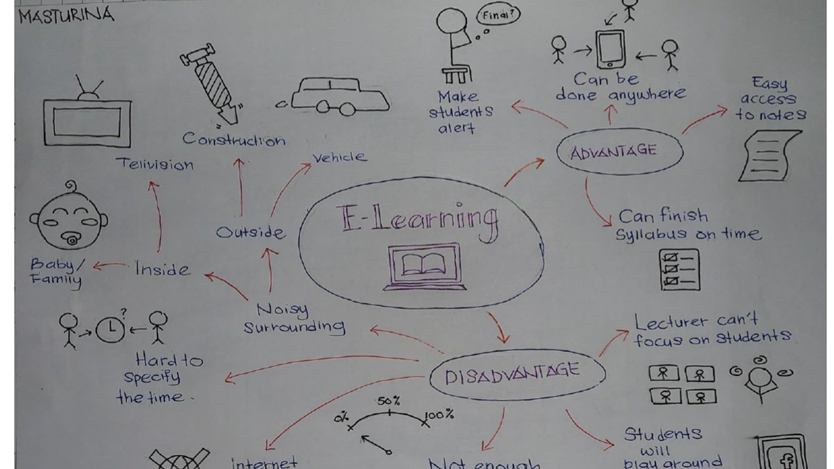
Sample 1
Samples of evidence on how students learn using the six steps strategy consisting of Rich Picture

Slide 4
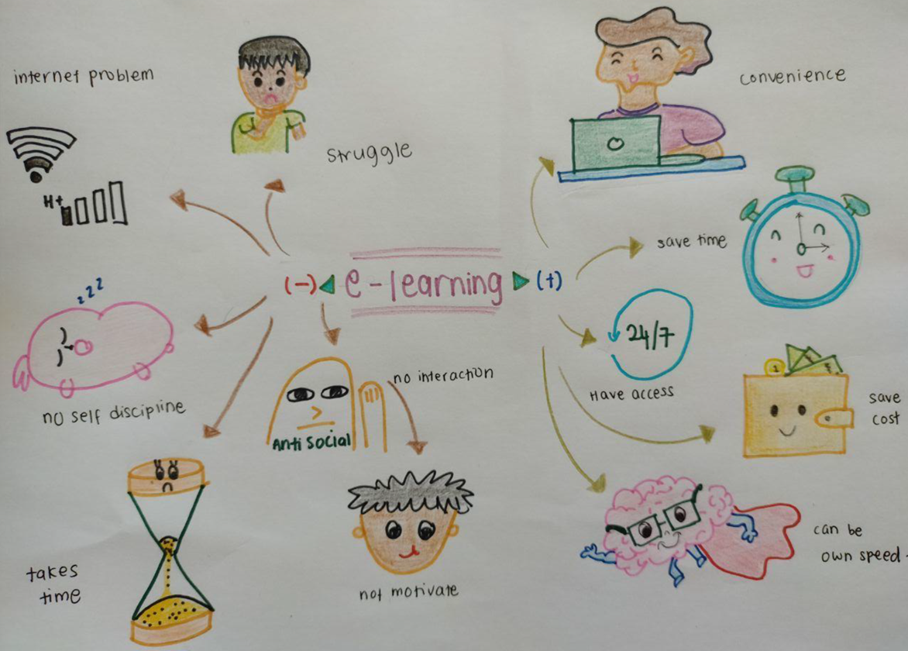
Sample 2

