Slide 1
GUIDELINE FOR SGD MARK TEMPLATE
Table of content | Slide
1. GUIDELINE FOR SGD MARK TEMPLATE for FACILITATOR | 3 – 8
2. GUIDELINE FOR SGD MARK TEMPLATE for COURSE COORDINATOR | 9 – 17
3. Link for both mark templates | 18
4. HOW TO DOWNLOAD THE MARK TEMPLATES from GDrive | 19 – 20

Slide 2
GUIDELINE FOR SGD MARK TEMPLATE
for
FACILITATOR
(Slide 3 – 8)

Slide 3
STEP 1 : Download the template from email or link in slide 18.
Educational purpose only

Slide 4
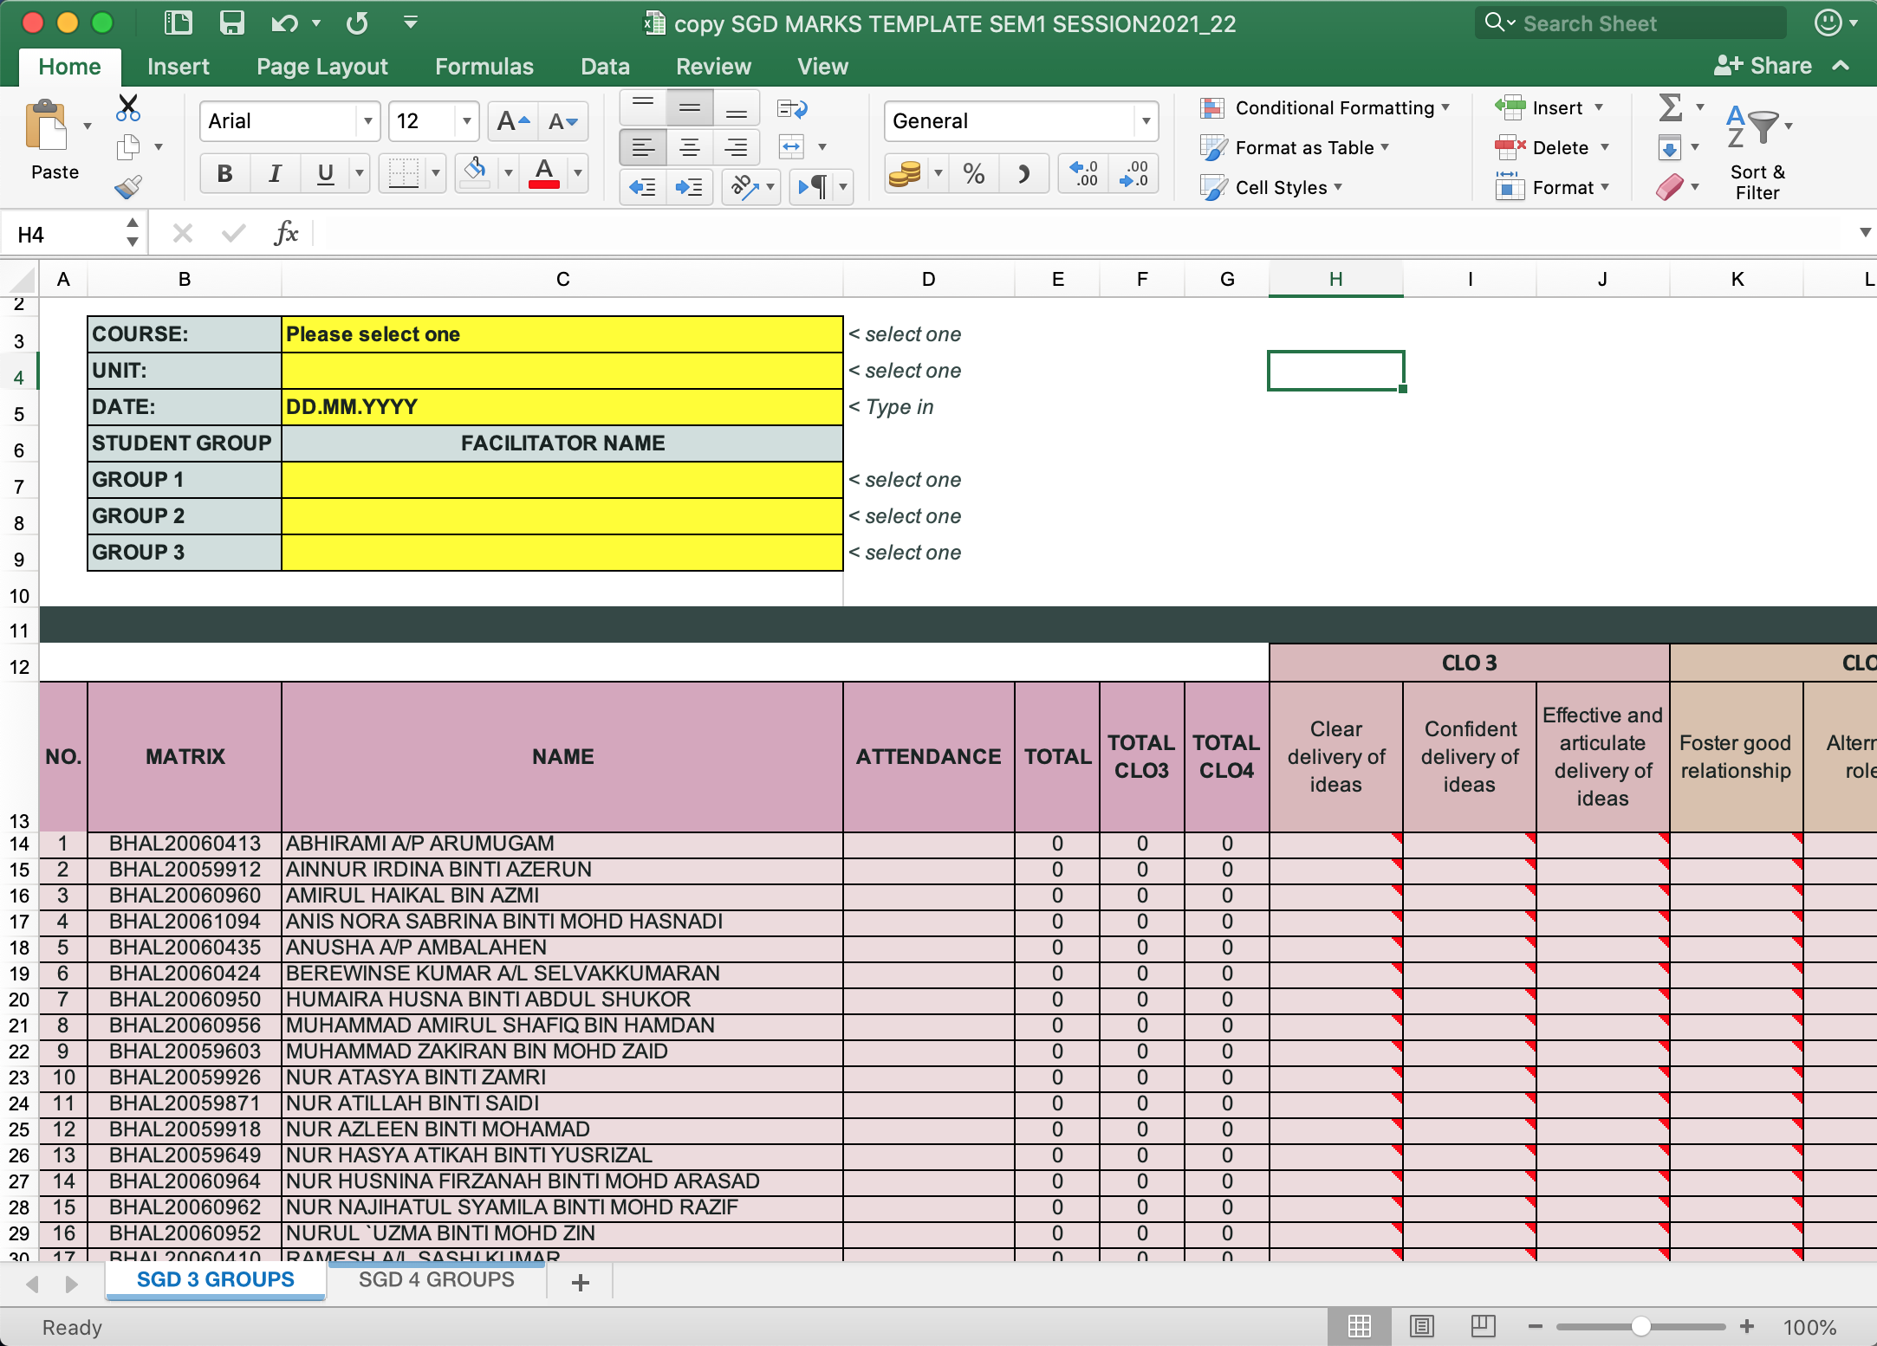
STEP 2 : Choose “SGD 3 GROUPS” or “SGD 4 GROUPS” depending on unit.

Slide 5
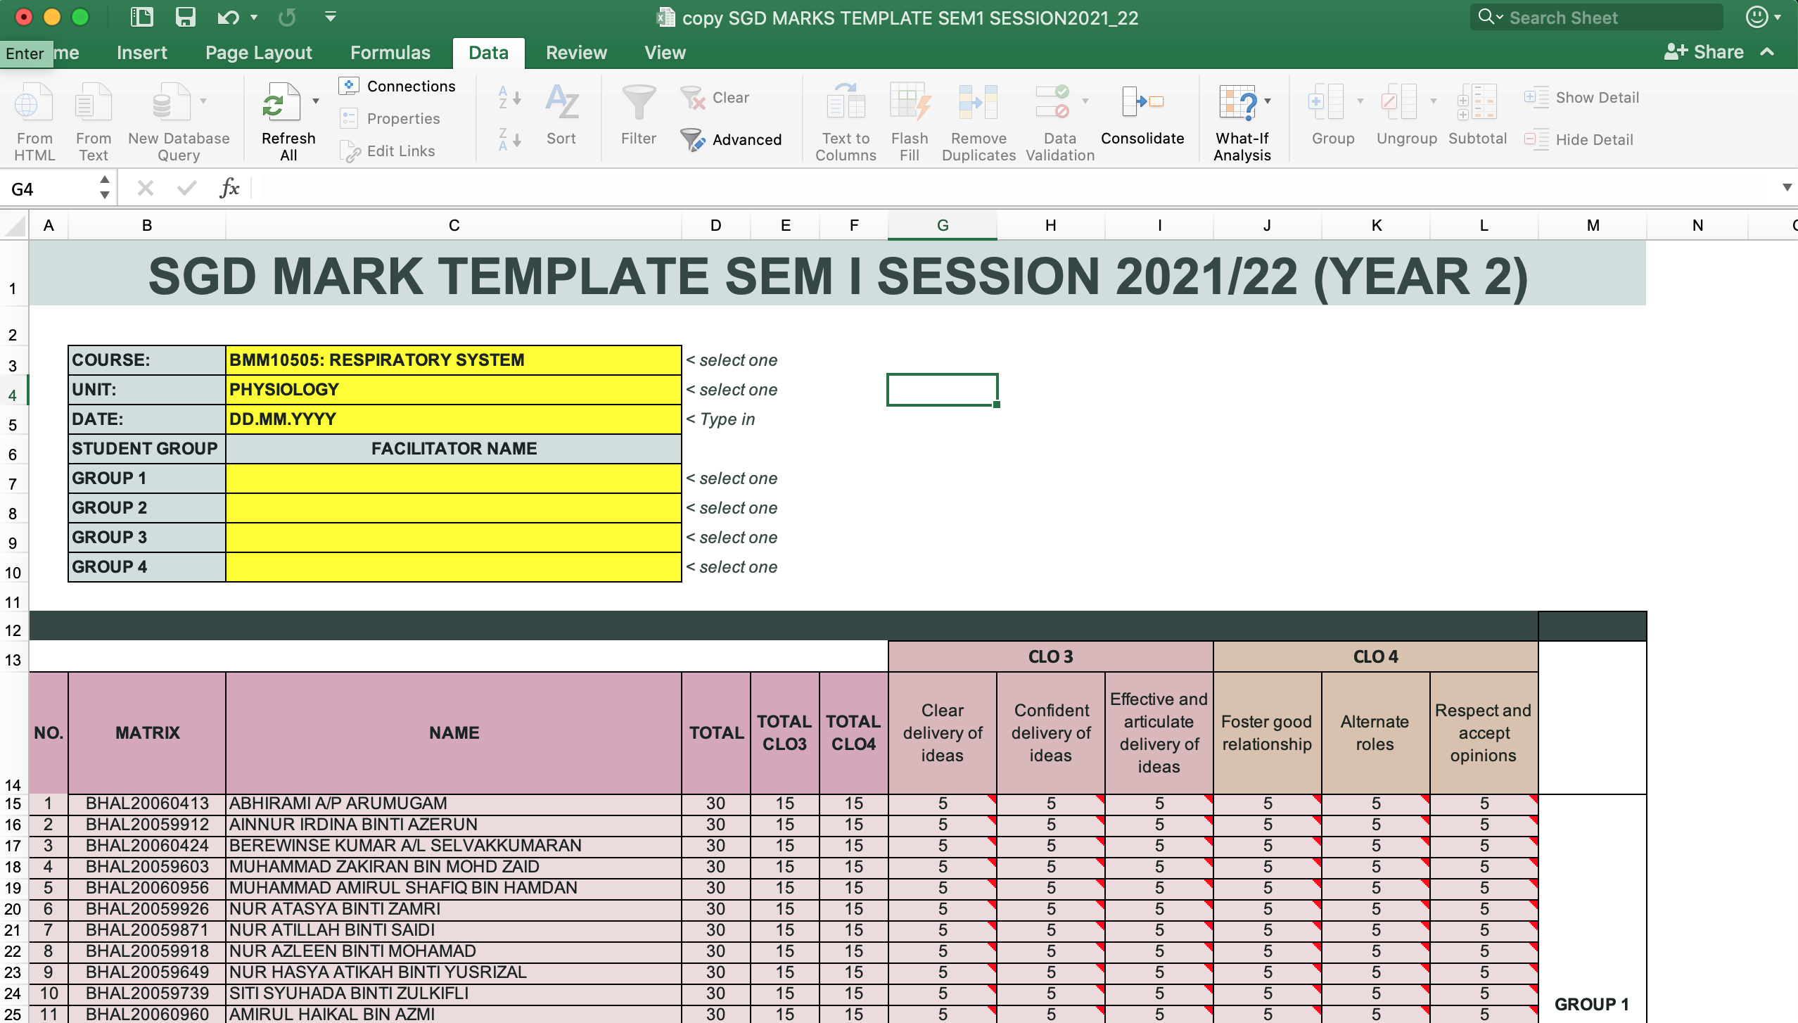
STEP 3: Fill in all required infos
Educational purpose only

Slide 6
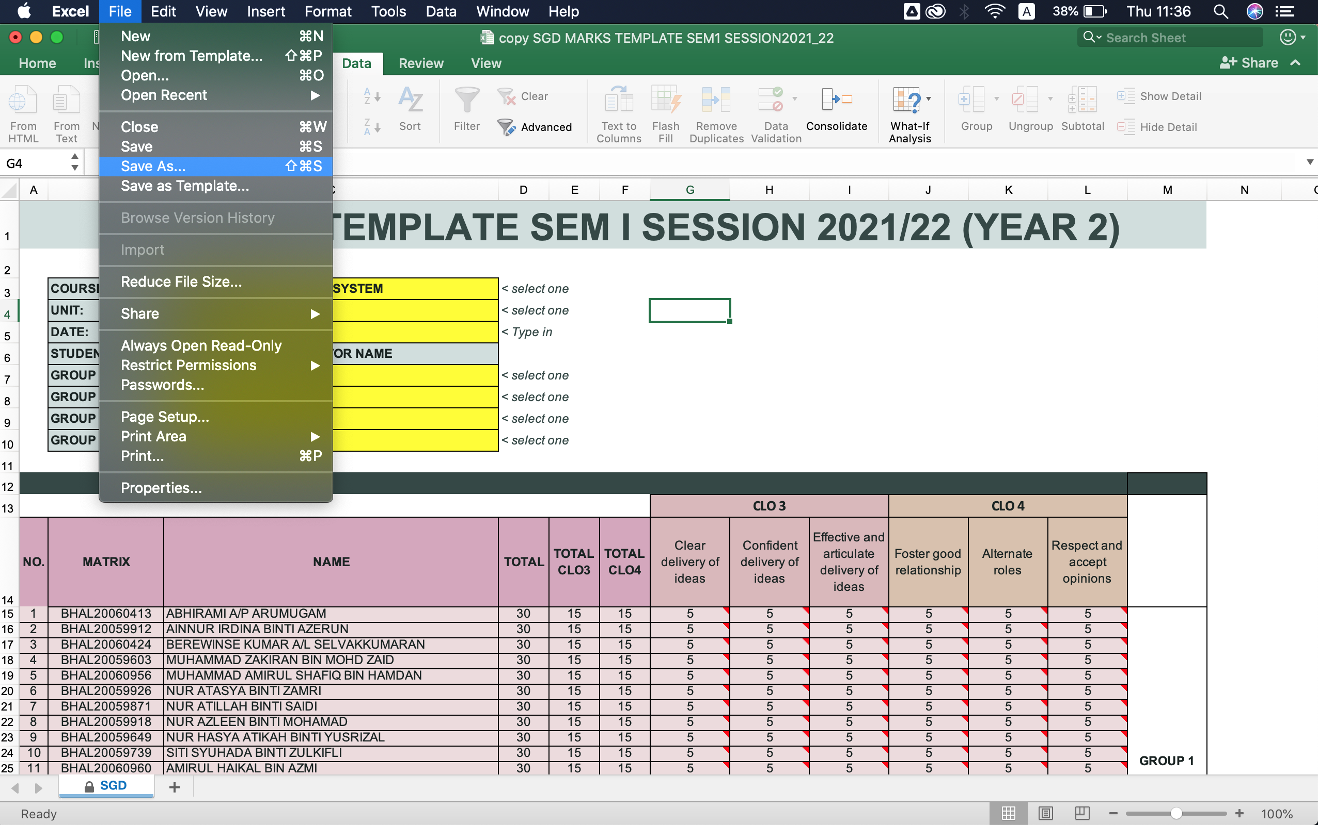
STEP 4: Save the doc as: 1. excel document, 2. pdf.
Save 1 copy as it is.
Save 1 copy as pdf.
Educational purpose only

Slide 7
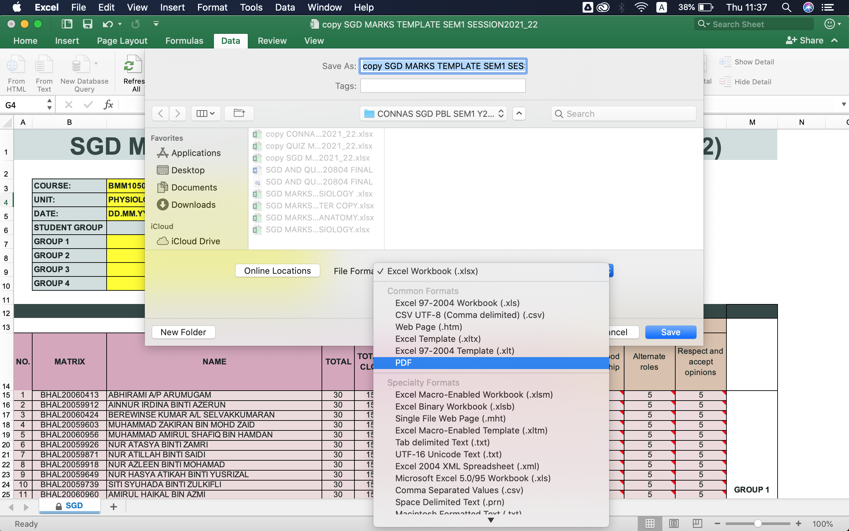
STEP 5: Save the doc as: 1. excel document, 2. pdf.
Educational purpose only

Slide 8
STEP 6: Email completed SGD marks template to respective course coordinator.
Document that needs to be included.
Educational purpose only
Educational purpose only

Slide 9
GUIDELINE FOR SGD MARK TEMPLATE
for
COURSE COORDINATOR
(Slide 9 – 17)

Slide 10
STEP 1 : Download the completed SGD marks from each facilitator.
Educational purpose only

Slide 11
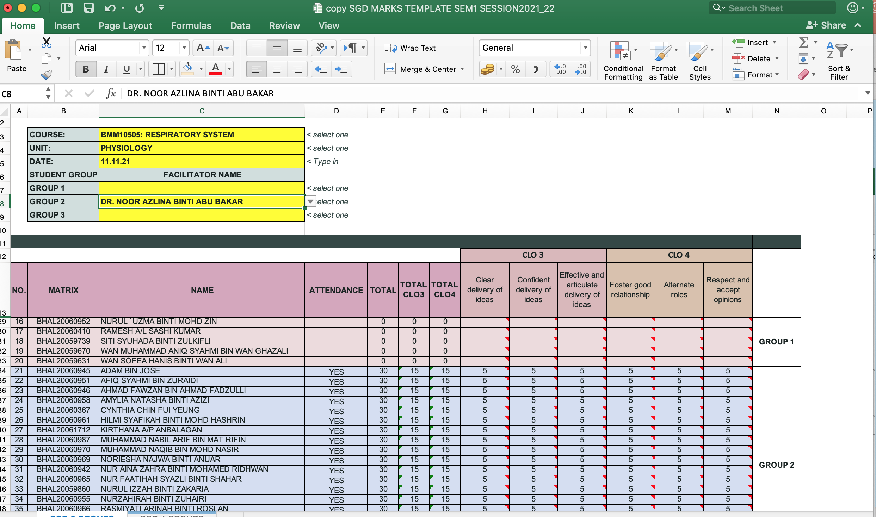
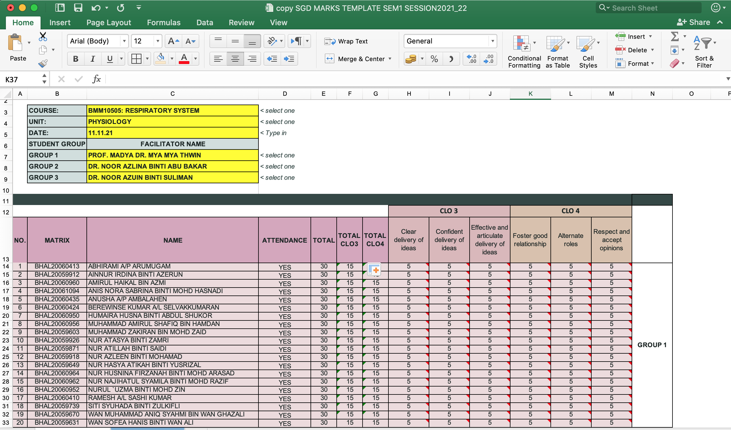
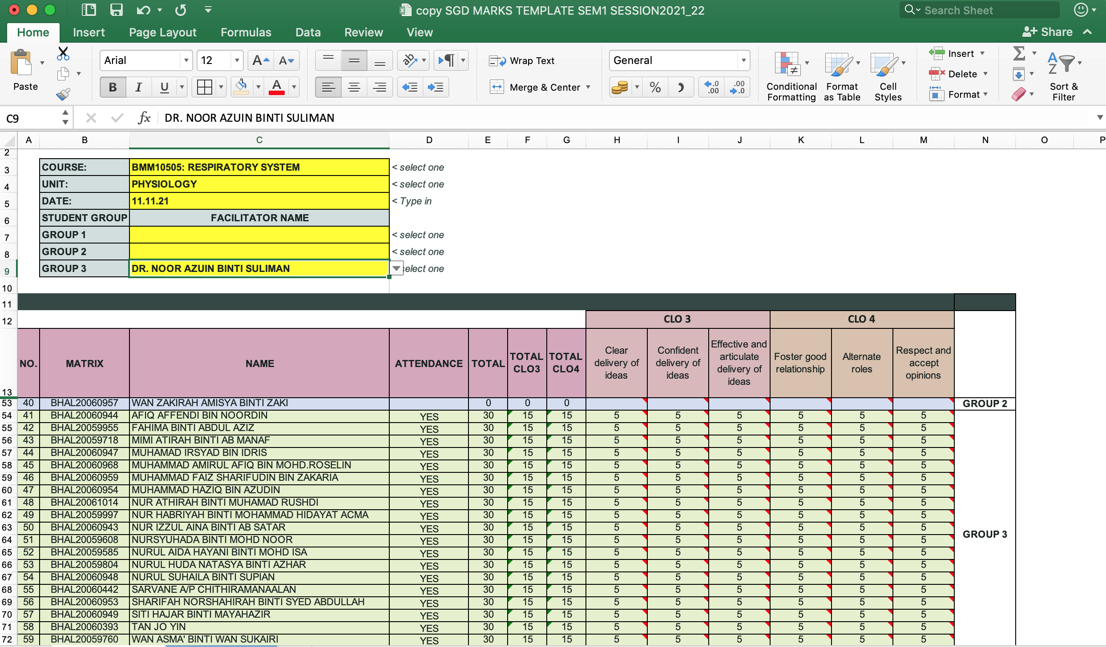
STEP 2: Compile SGD marks from same unit members into one sheet according to group number (group of 3 or 4)
Step 2.1: Group 2
Step 2.4: Fill in also facilitators name into group 1 template.
Step 2.3: Copy marks and attendance from group 2 and 3 (of same unit) into template group 1.
Step 2.2: Group 3

Slide 12
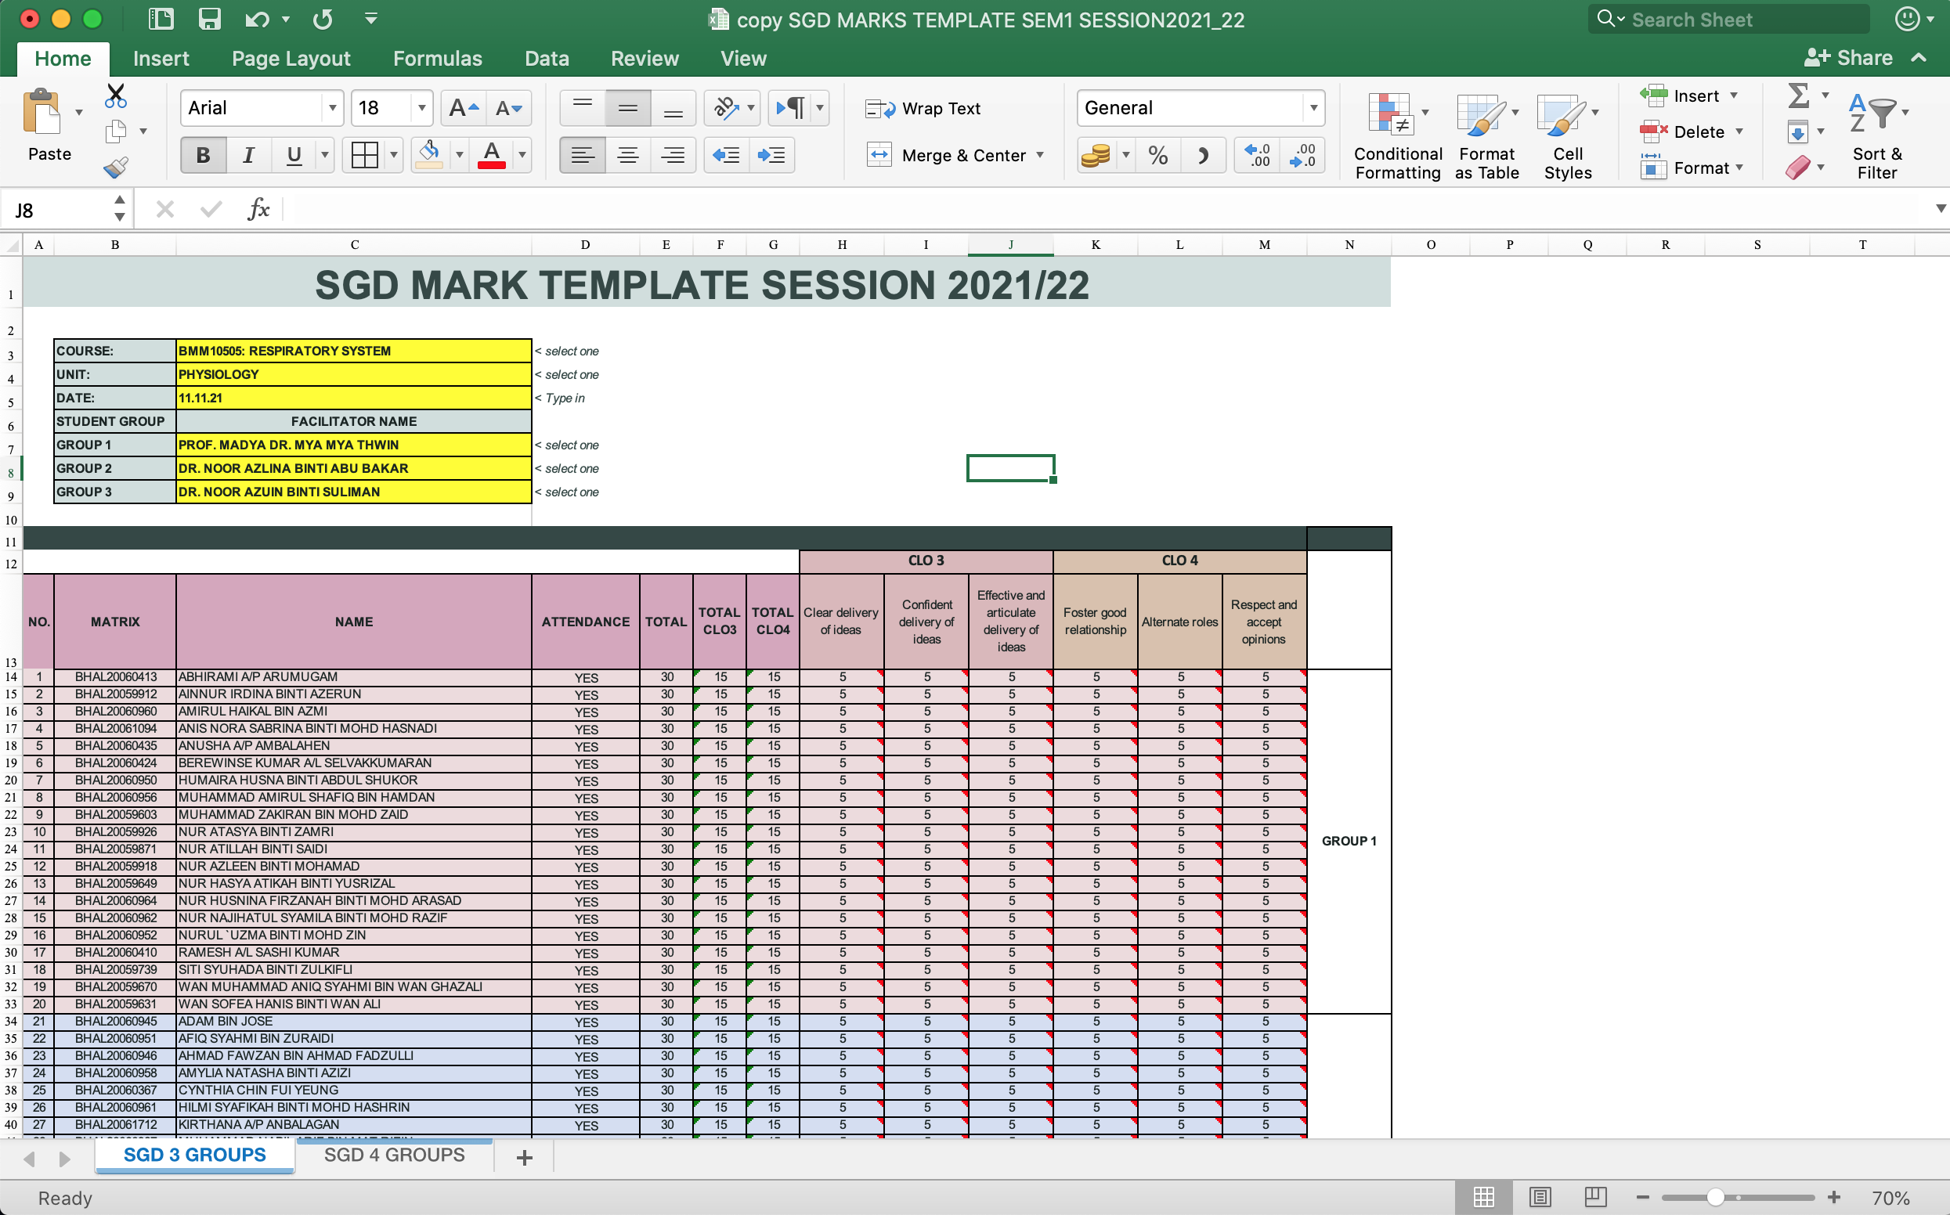
STEP 3: Once finished compiling all marks for 1 unit in 1 sheet, now sort student name according to matric number.
How to sort student name according to matric number?

Slide 13
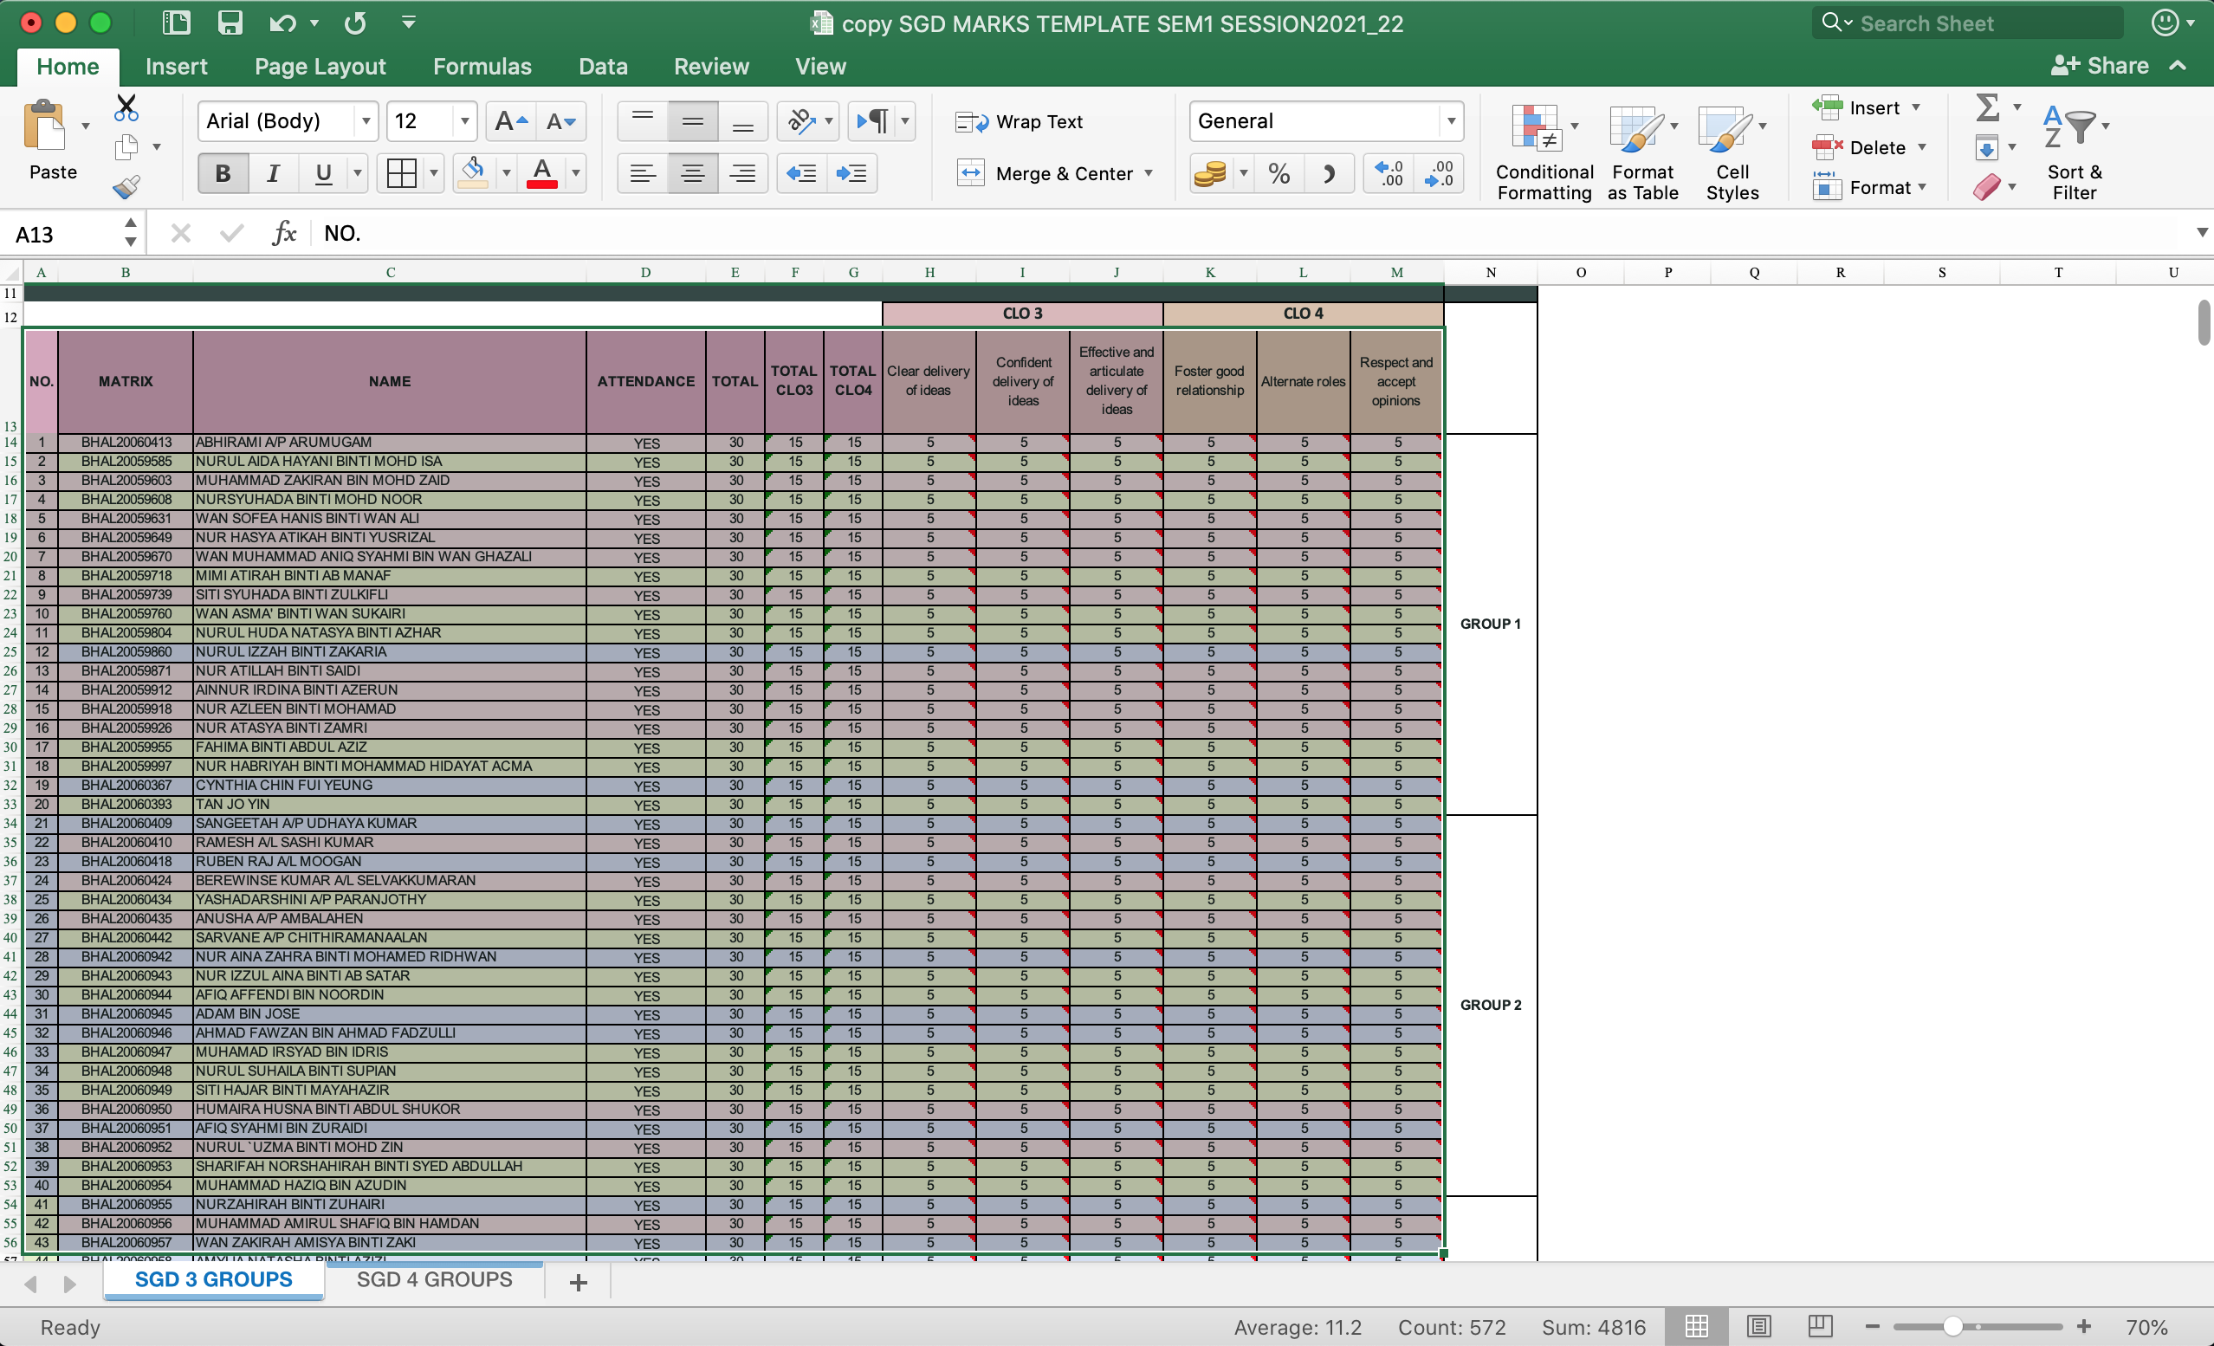
STEP 3.1: sort student name according to matric number.
Highlight column B (start from row MATRIC= row13) until column M for all student

Slide 14
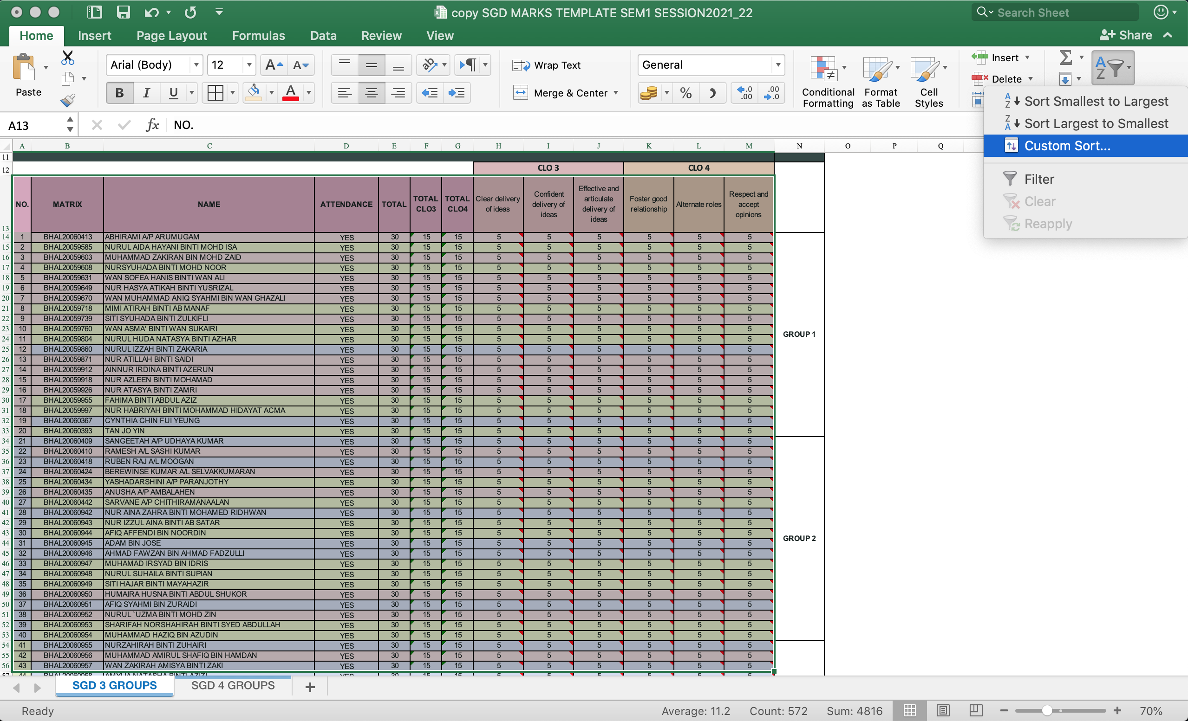
STEP 3.1: sort student name according to matric number cont.
Go to “sort & filter” menu then choose “Custom sort”.

Slide 15
STEP 3.1: sort student name according to matric number cont.
Sort by “MATRIC” then click “OK”.
You will notice now all students are arranged following matric number sequence.

Slide 16
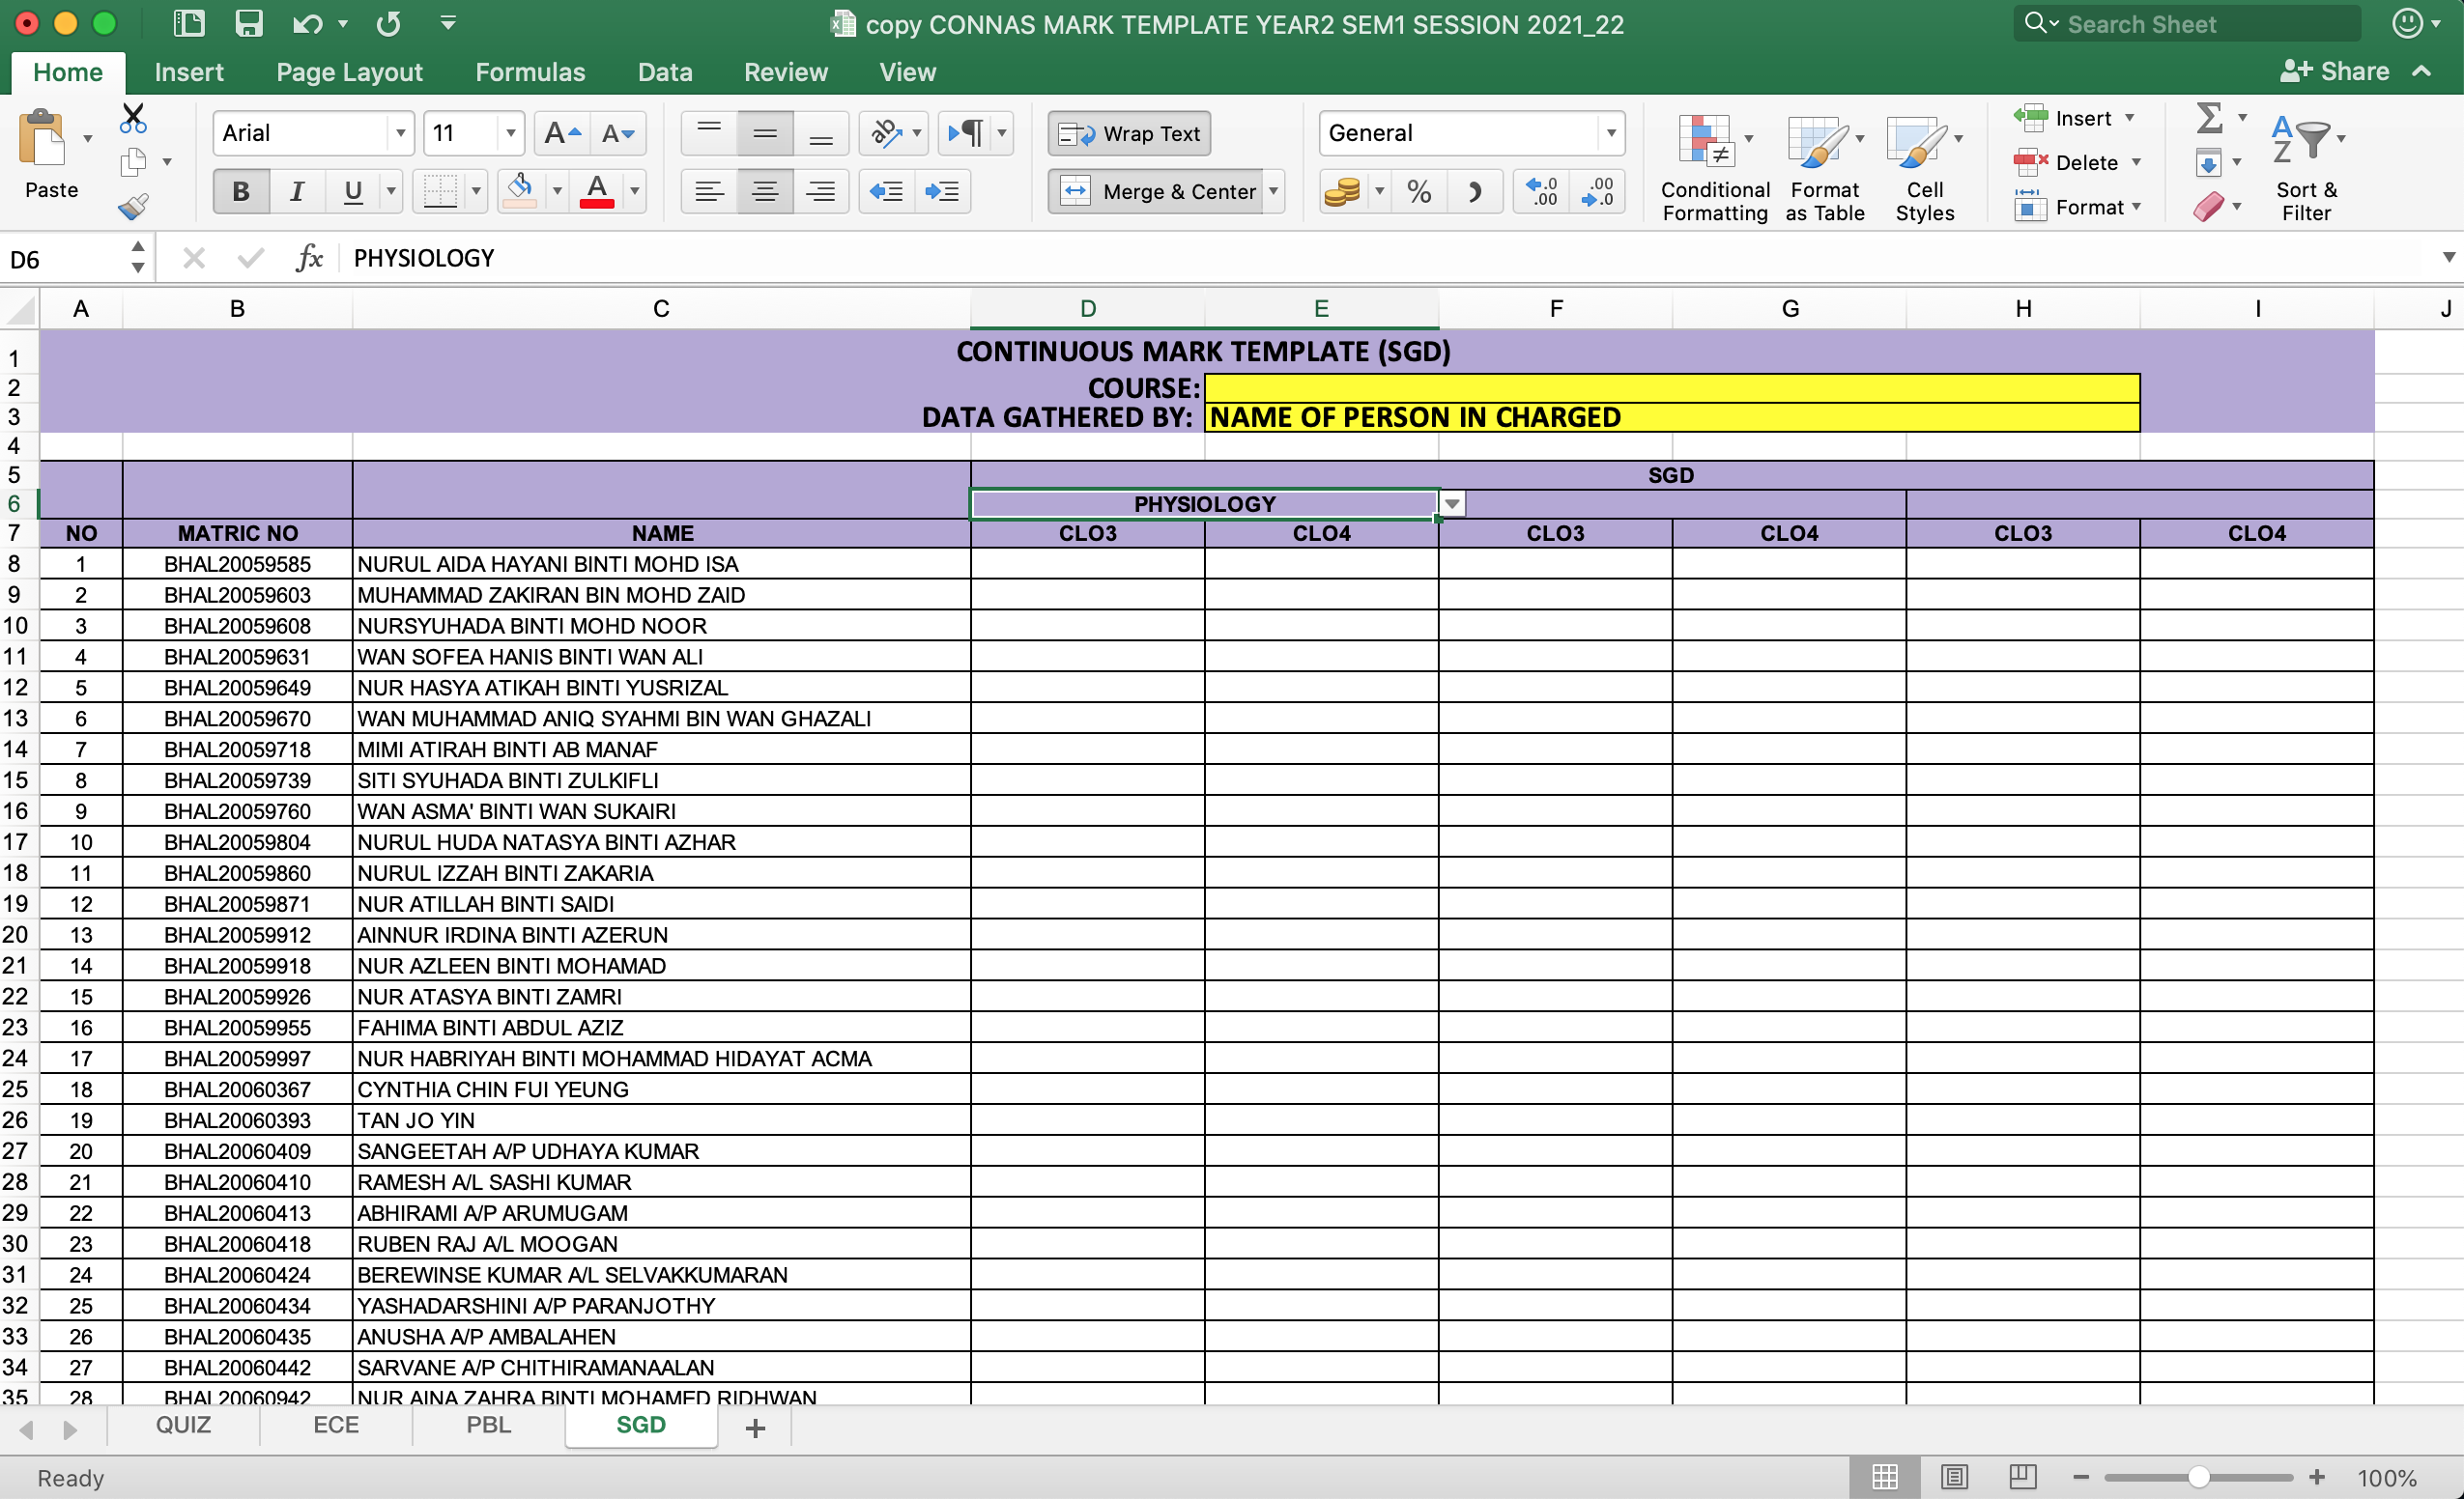
STEP 3.1: Now you are ready to copy sorted CLO3 and CLO 4 marks into CONNAS mark template.
Highlight CLO3 and CLO4 marks of all students, then “copy” and “paste” into “CONNAS MARK TEMPLATE EXCEL”
REMARKS: Please double check unit, student name and marks with original sheet to ensure NO key in or technical mistake.
Students in CONNAS MARK TEMPLATE are arrange following matric number sequence.

Slide 17
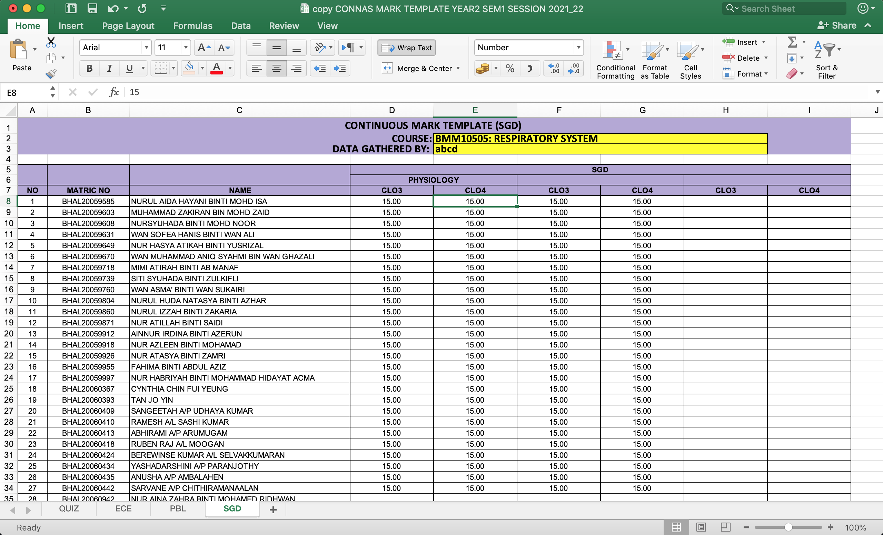
STEP 4: Completed CONNAS MARKS TEMPLATE (PBL, ECE, SGD & QUIZ) shall be email to EXAM COORDINATOR.

Slide 18
If you miss the copy of the marks template, you may download the template using attached links:
Copy of SGD mark template for facilitators: https://docs.google.com/spreadsheets/d/1hCwRMOpi9LKDz6srmCm0XFhMcypakJSM/edit?usp=sharing&ouid=105713722641740098348&rtpof=true&sd=true
Copy of CONNAS mark template for course coordinator: https://docs.google.com/spreadsheets/d/12dMBe_VH9YV5YPIcpqbQieBEEKMXsNsH/edit?usp=sharing&ouid=105713722641740098348&rtpof=true&sd=true
Copy of QUIZ mark template: https://docs.google.com/spreadsheets/d/1ISQDSe6-qJ9YfQGgBUBDUAIilCbmVmTS/edit?usp=sharing&ouid=105713722641740098348&rtpof=true&sd=true

Slide 19
HOW TO DOWNLOAD THE MARK TEMPLATES
from
GDrive
(Slide 19 – 20)

Slide 20
STEP 1: Click the link given (Slide 18) then go to file > Download > Microsoft Excel (.xlsx).

Slide 21
Thank you.
Educational purpose only

